Slide 1

My journal to Python
Name: 錢德羅
Teacher: My dear great Teacher

Slide 2

Agenda
Python
Input and output: input() and print()
Data types: numeric, string, list, dict.
Operation On data type:
CONTROLS:IF- | IF –ELSIF |-F-ELSE
LOOP:FOR |WHILE | RANGE() | BREAK | CONTINUE
FUNCTION:
PARAMETERS(ARGUMENTS)
RECURSIVE FURNCTION
LAMBA FUNCTION

Slide 3
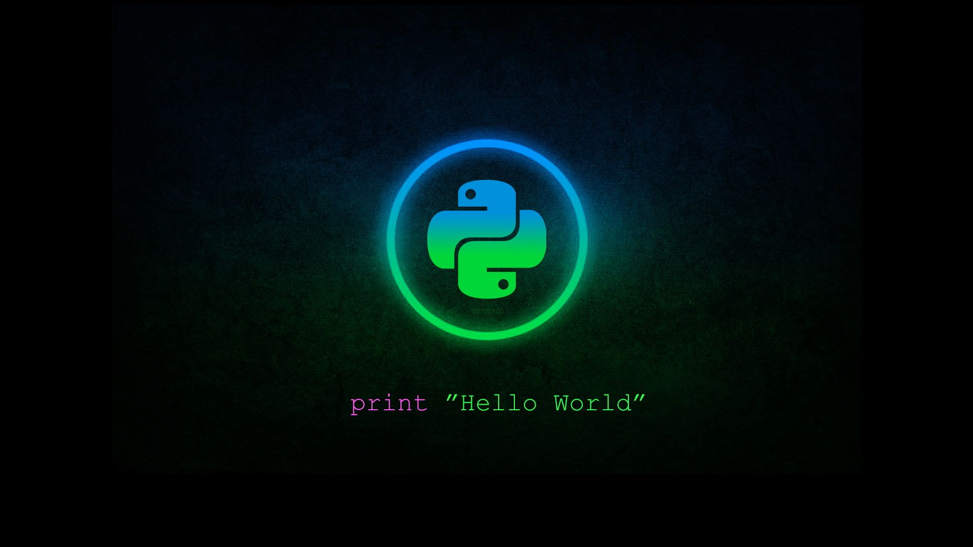
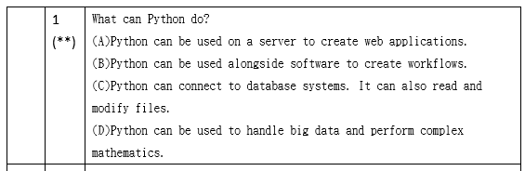
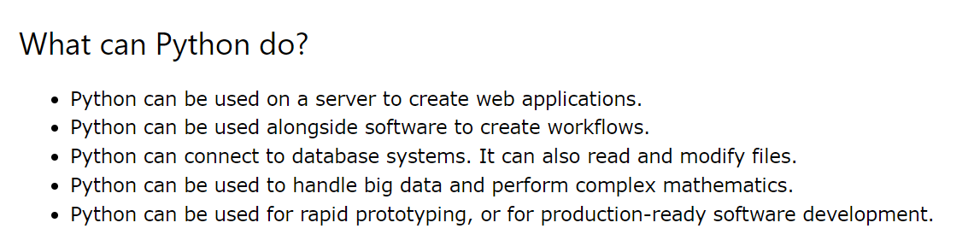
PYTHON
https://www.w3schools.com/python/python_intro.asp

Slide 4
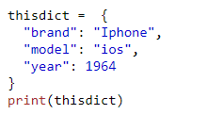
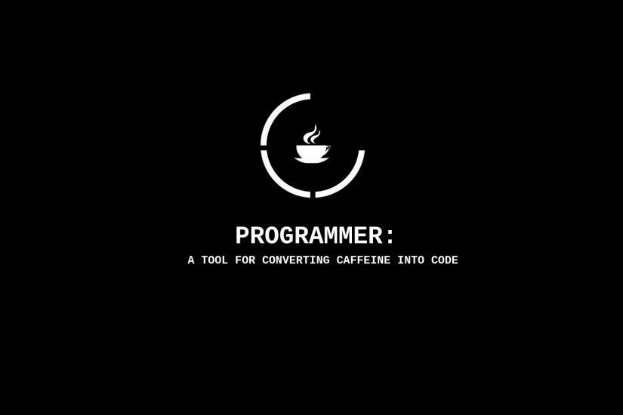
Data types: Dictionary
key value
Dictionaries are used to store data values in key:value pairs.
A dictionary is a collection which is ordered*, changeable and do not allow duplicates.
As of Python version 3.7, dictionaries are ordered.
In Python 3.6 and earlier, dictionaries are unordered.
Dictionaries are written with curly brackets, and have keys and values:
key:value pairs.

Slide 5
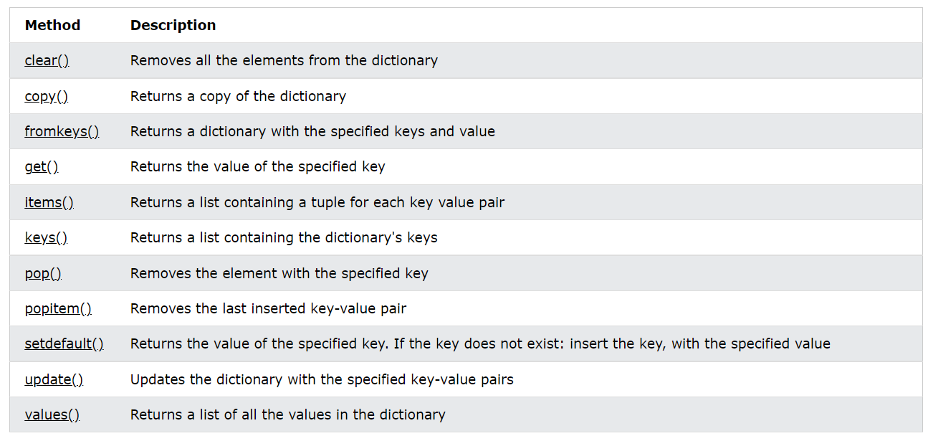
Dictionary Methods

Slide 6
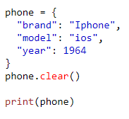
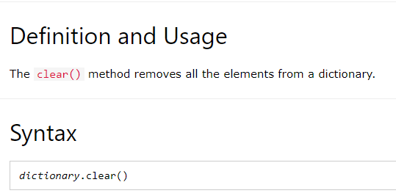
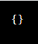
Clear() Method() Method ) Method

Slide 7
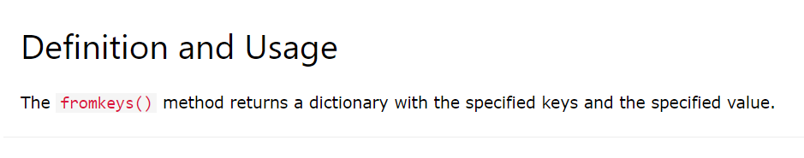
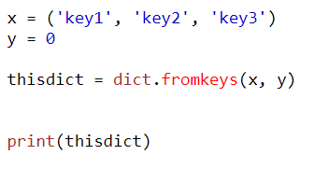
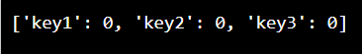
fromkeys() Method

Slide 8
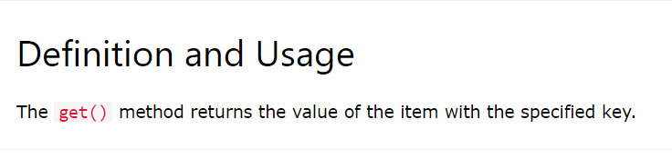
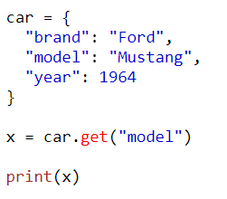
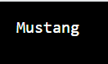
get() Method

Slide 9
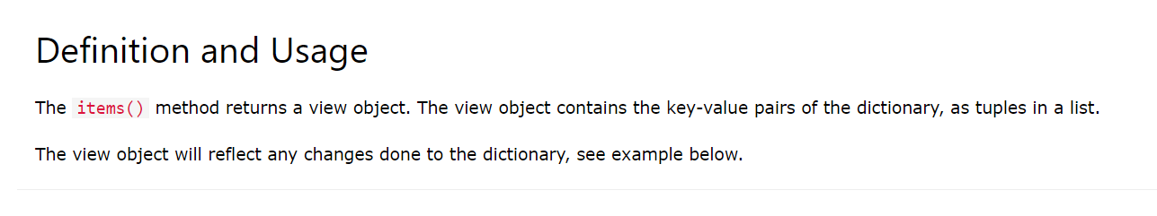
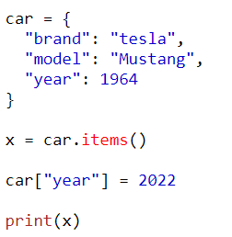
items() Method

Slide 10
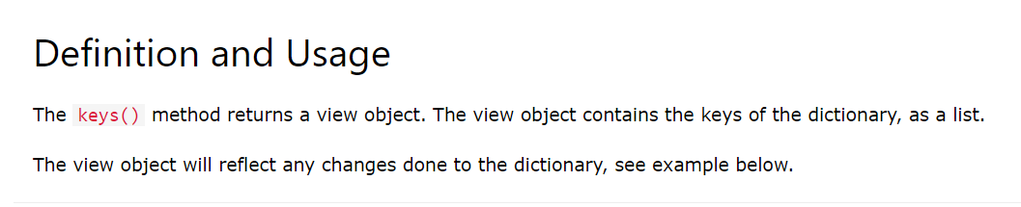
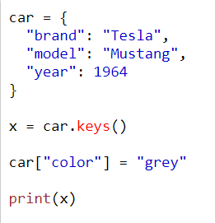
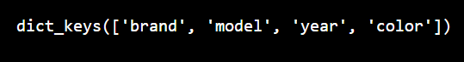
keys() Method

Slide 11
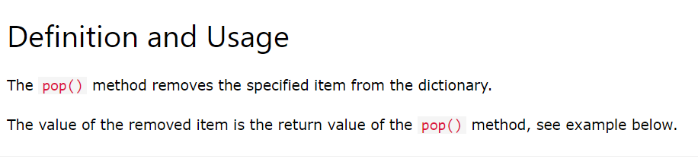
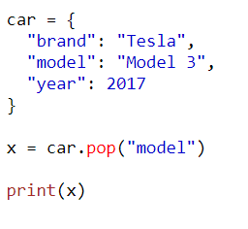
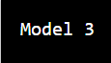
pop() Method

Slide 12
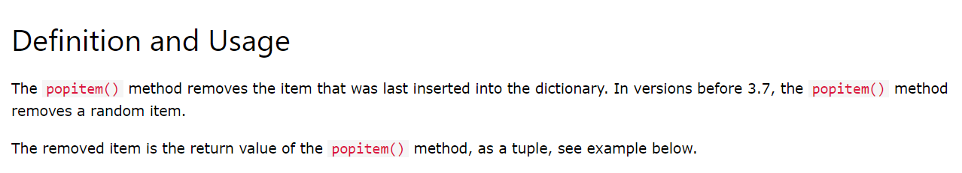
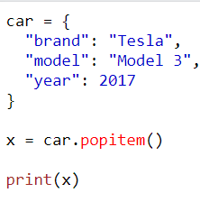
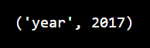
popitem() Method ❮ Dictionary Methods

Slide 13
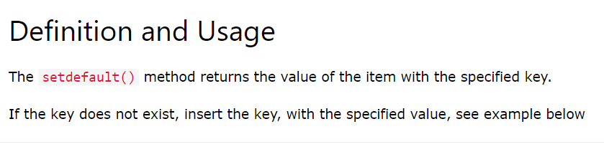
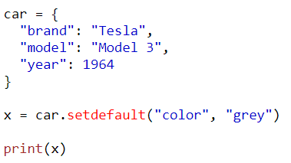
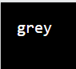
setdefault() Method

Slide 14
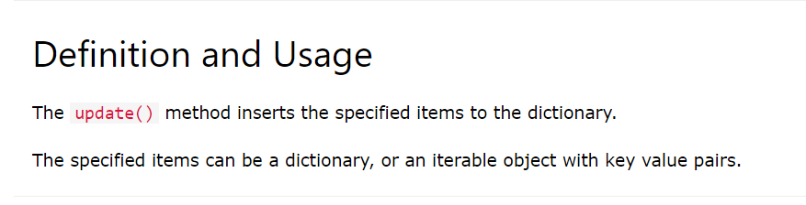
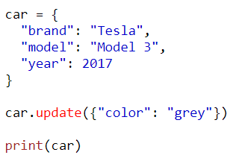
update() Method

Slide 15
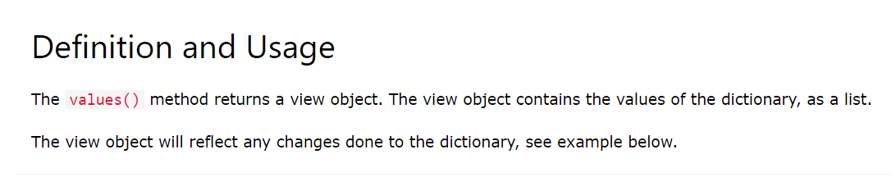
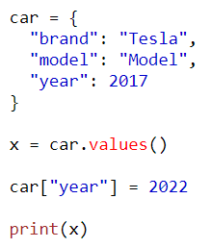
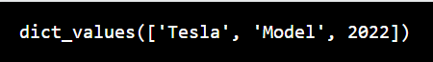
values() Method

Slide 16
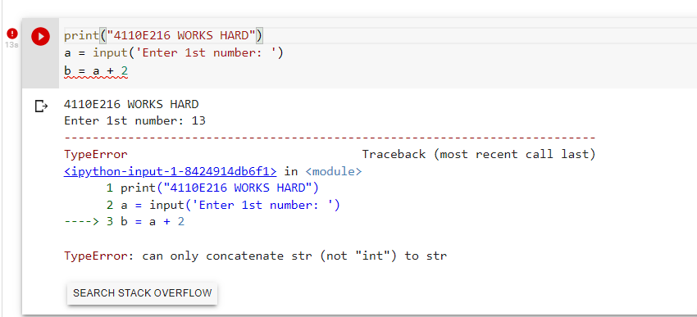
Input and output
Question:

Slide 17
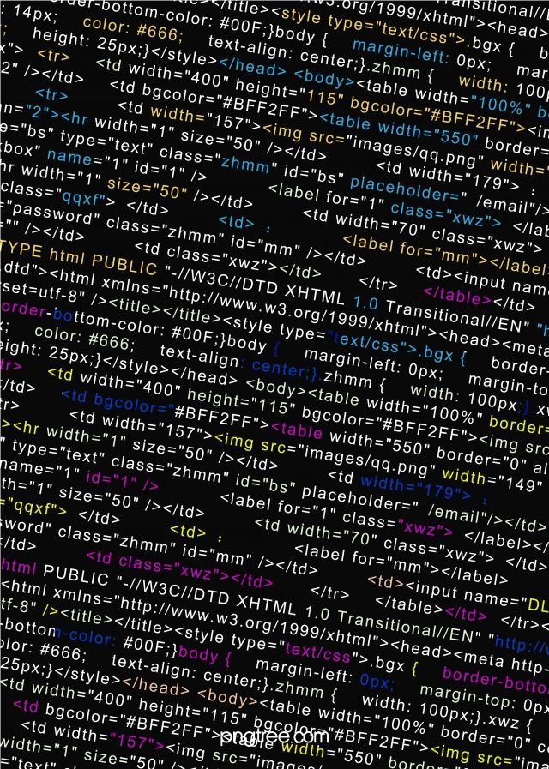
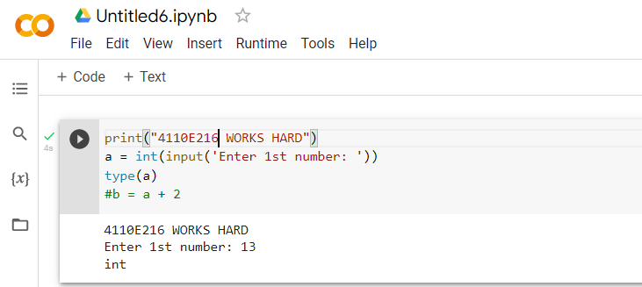
Way: 1

Slide 18

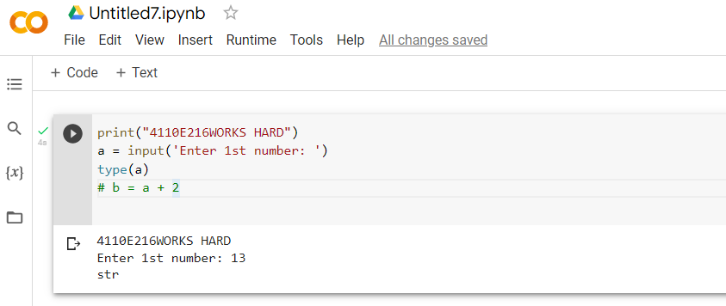
Way: 2

Slide 19

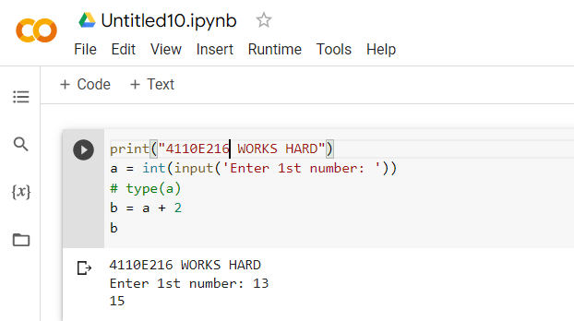
Answer:1

Slide 20

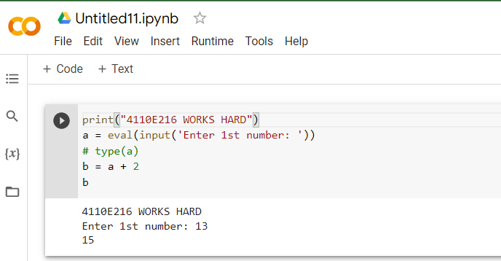
Answer:2

Slide 21
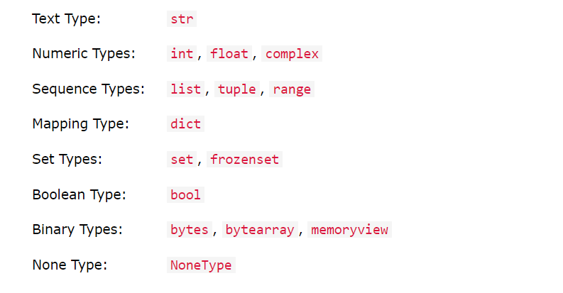
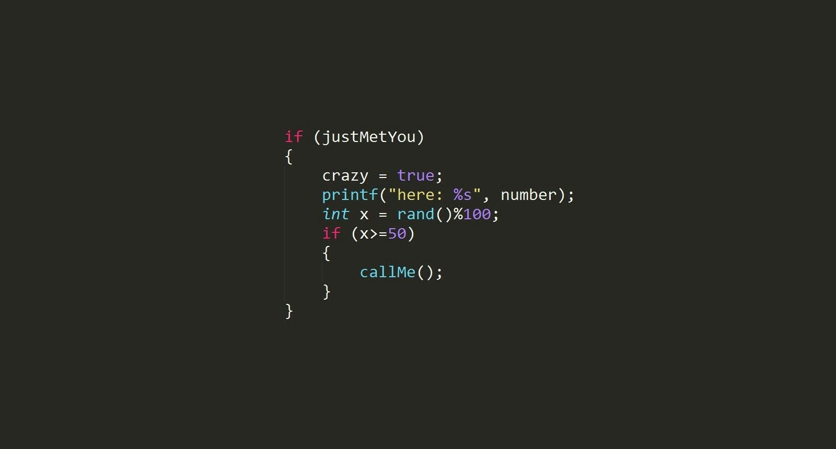
DATA TYPES:

Slide 22
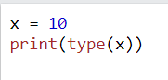
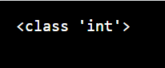
EXAMPLE:

Slide 23
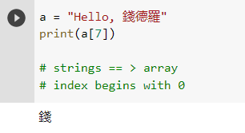
DATA TYPES Python Strings
Strings are python are arrays of bytes representing Unicode characters.

Slide 24
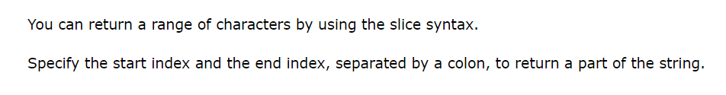
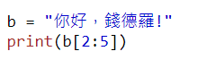
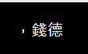
Python - Slicing Strings

Slide 25
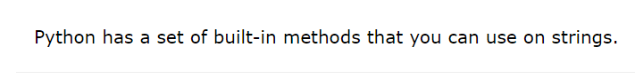
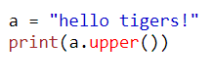

Python - Modify Strings

Slide 26



Python - String Concatenation

Slide 27


Python - Format - Strings

Slide 28


Python - String Methods

Slide 29



Slide 30



Python String capitalize() Method ❮ String Metho

Slide 31



Python String casefold() Method

Slide 32



Python String center() Method

Slide 33



Python String count() Method

Slide 34



Python String encode() Method ❮ String Method

Slide 35



Python String endswith() Method ❮ String Methods

Slide 36



Python String expandtabs() Method

Slide 37



Python String find() Method ❮ String Methods

Slide 38



Python String format() Method

Slide 39



Python String index() Method

Slide 40



Python String isalnum() Method ❮ String Methods

Slide 41



Python String isalpha() Method

Slide 42



Python String isascii() Method

Slide 43



Python String isdecimal() Method ❮ String Methods

Slide 44



Python String isdigit() Method ❮ String Methods

Slide 45



Python String isidentifier() Method ❮ String Methods

Slide 46



Python String islower() Method

Slide 47



Python String isnumeric() Method ❮ String Methods

Slide 48



Python String isprintable() Method

Slide 49



Python String isspace() Method

Slide 50



Python String istitle() Method

Slide 51



Python String isupper() Method ❮ String Methods

Slide 52



Python String join() Method

Slide 53



Python String ljust() Method ❮ String Methods

Slide 54


Python String lstrip() Method

Slide 55



Python String maketrans() Method ❮ String Methods

Slide 56



Python String partition() Method

Slide 57



Python String replace() Method

Slide 58



Python String rfind() Method

Slide 59



Python String rindex() Method

Slide 60



Python String rjust() Method ❮ String Methods

Slide 61



Python String rsplit() Method

Slide 62



Python String rstrip() Method

Slide 63



Python String splitlines() Method

Slide 64



Python String startswith() Method

Slide 65



Python String swapcase() Method ❮ String Method

Slide 66



Python String translate() Method ❮ String Methods

Slide 67



Python String zfill() Method

Slide 68



Python Lists:

Slide 69


Python - Access List Items

Slide 70


Python - Change List Items

Slide 71


Python - Add List Items

Slide 72



Python - Remove List Items

Slide 73



Python - Loop Lists

Slide 74


Python - List Comprehension

Slide 75


Python - Sort Lists

Slide 76


Python - Copy Lists

Slide 77



Python - Join Lists

Slide 78

Python - List Methods

Slide 79



Python List append() Method ❮ List Methods

Slide 80



Python List clear() Method

Slide 81



Python List copy() Method

Slide 82



Python List count() Method

Slide 83



Python List extend() Method

Slide 84



Python List index() Method

Slide 85



Python List insert() Method ❮ List Method

Slide 86



Python List pop() Method

Slide 87



Python List remove() Method ❮ List Methods

Slide 88



Python List reverse() Method ❮ List Methods

Slide 89







Python Operators

Slide 90



Python If ... Else

Slide 91


Elif

Slide 92



Python For Loops

Slide 93


Python While Loops

Slide 94



The range() Function

Slide 95


The break Statement

Slide 96


The continue Statement

Slide 97


Parameters or Arguments

Slide 98



Recursion

Slide 99



Python Lambda

Slide 100
THANK YOU!
CHINES NAME: 錢德
STUDENT ID: 4110E216
ENGLISH NAME: Chandro S. Ermitanio
NICKNAME: Chan/Chand
Email: chandroermitanio95@gmail.com
GITHUB: https://github.com/4110e216/cs2022.git

